Slide 1
01 | Introduction to Bootstrap
Christopher Harrison
@geektrainer
Content Developer
Microsoft

Slide 2
Setting Expectations
Not going to cover everything in Bootstrap
Help get you up and running on building great looking sites
Some CSS and HTML experience required
Plenty of resources available
Lots of demos
Proof of concept
Labs supplement course
Apply skills in a "real world" scenario

Slide 3
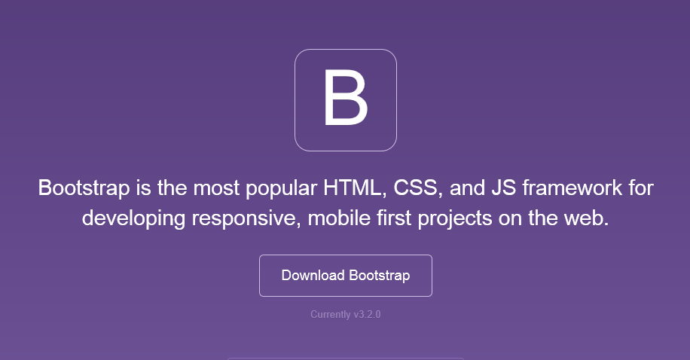
Bootstrap
The most popular front-end framework for developing responsive, mobile first projects on the web.

Slide 4
Why use it?
CSS is can be tricky
Cross browser support can be a challenge
Solves basic tasks (e.g. page layout without tables)
Bootstrap 3 makes it easier

Slide 5
Bootstrap Features
Theme Support
Responsive
Grid
Components
Pagination
Buttons
Modal
Great Visual Studio support

Slide 6





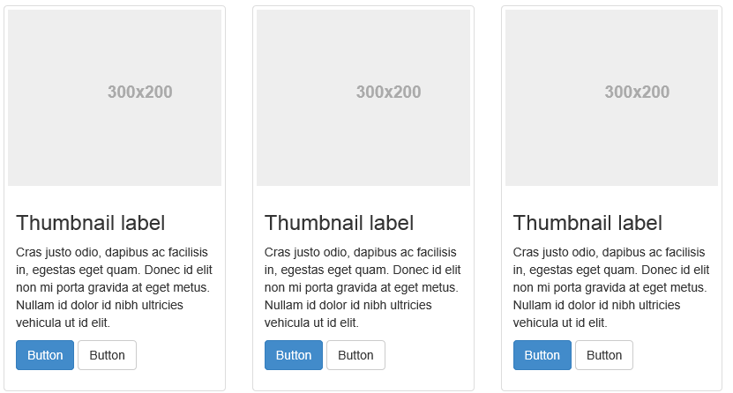
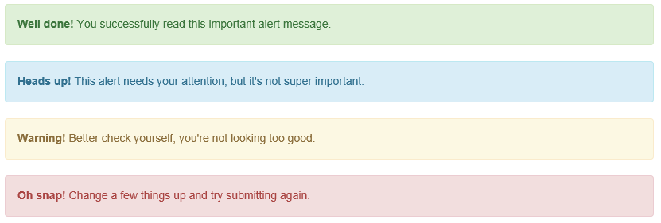
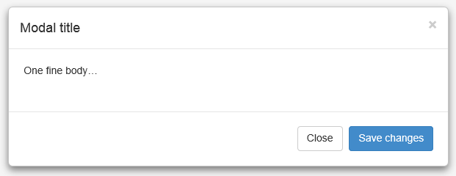
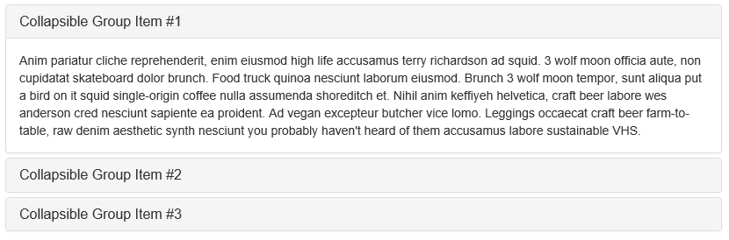
Components

Slide 7
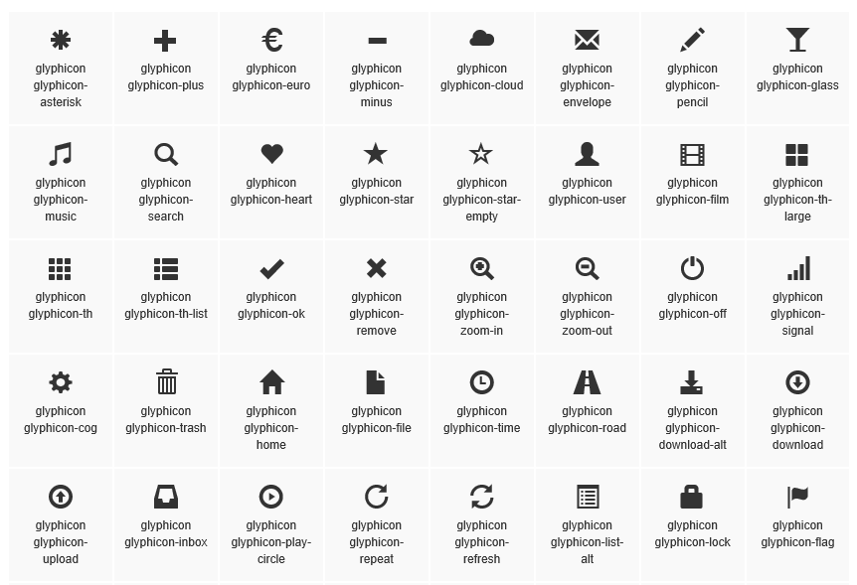
Glyphicons

Slide 8
A quick lap around Bootstrap

Slide 9
Theme Support

Slide 10
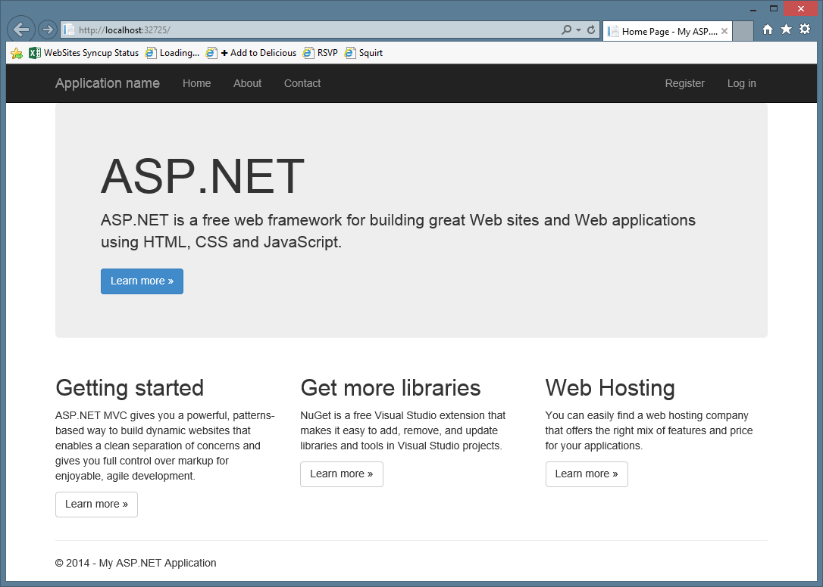

Slide 11
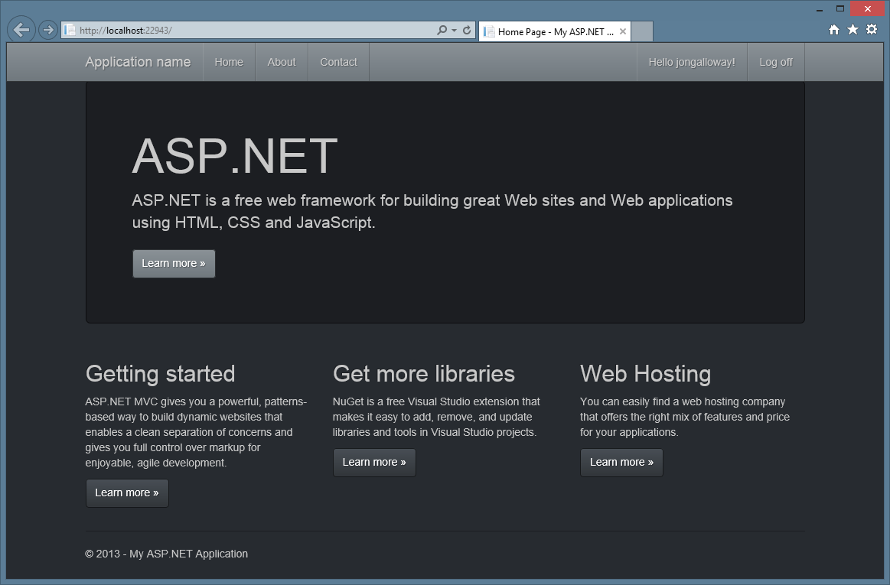

Slide 12
Bootstrap themes

Slide 13
Responsive Layout
Notes:
Bootswatch

Slide 14
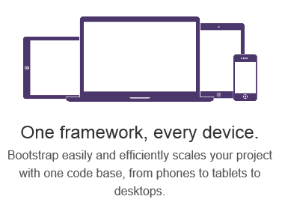
Responsive Layout

Slide 15
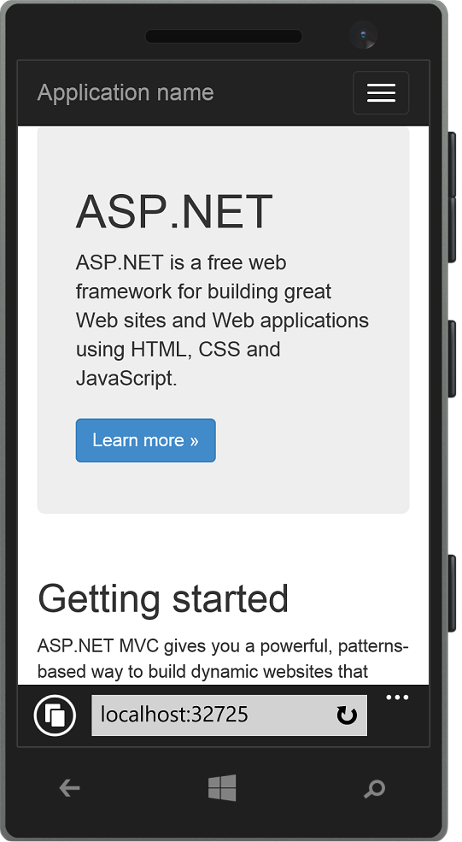
Responsive Layout

Slide 16
Responsive UI
Notes:
Show page responding to screen width changes
Show page in mobile browser
Emphasize that this is just HTML and CSS – no server or JS code

Slide 17
Grid System

Slide 18
Grid system
 | Extra small devices Phones (<768px) | Small devices Tablets (≥768px) | Medium devices Desktops (≥992px) | Large devices Desktops (≥1200px)
Grid behavior | Horizontal at all times | Collapsed to start, horizontal above breakpoints
Container width | None (auto) | 750px | 970px | 1170px
Class prefix | .col-xs- | .col-sm- | .col-md- | .col-lg-
# of columns | 12
Column width | Auto | 60px | 78px | 95px
Gutter width | 30px (15px on each side of a column)

Slide 19
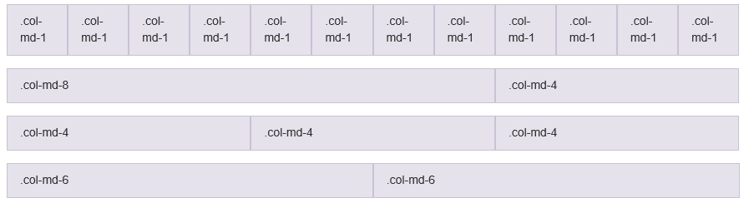
Grid system

Slide 20
Grid system
Notes:
Christopher - Grid

Slide 21
Visual Studio support

Slide 22
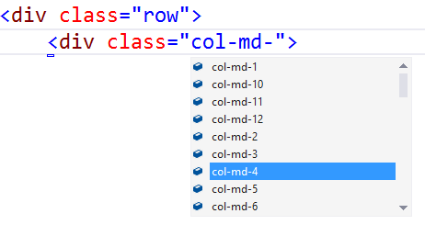
Visual Studio – Class IntelliSense

Slide 23
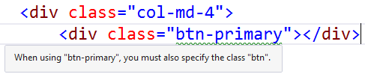
Visual Studio – Missing Class Detection

Slide 24
Visual Studio Support

